Slide 1
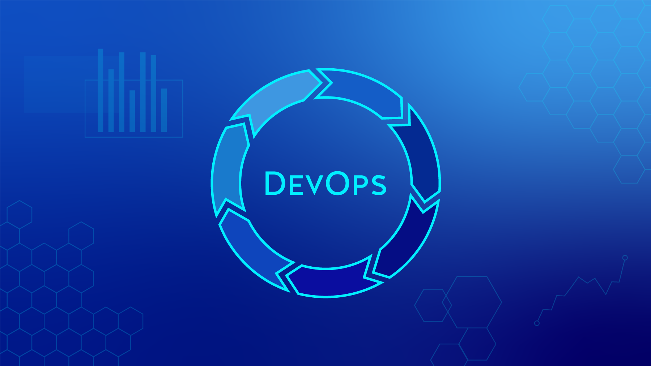

Slide 2
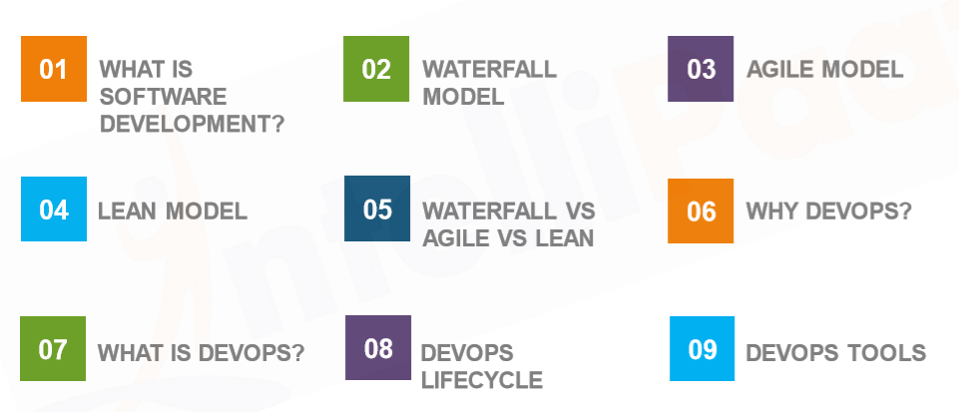
AGENDA

Slide 3
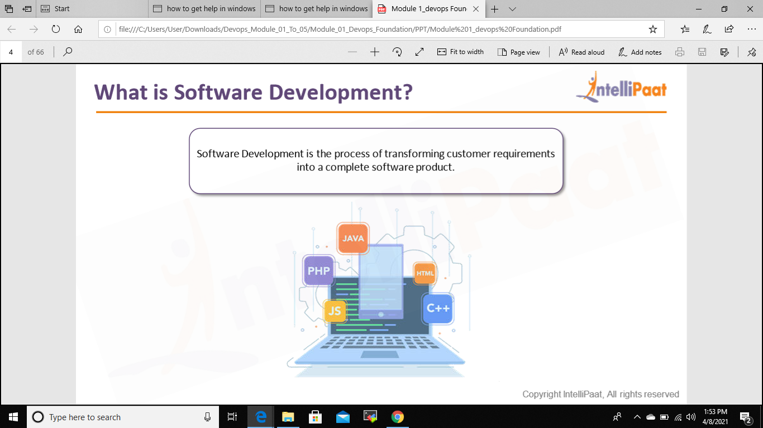
What is software development?

Slide 4
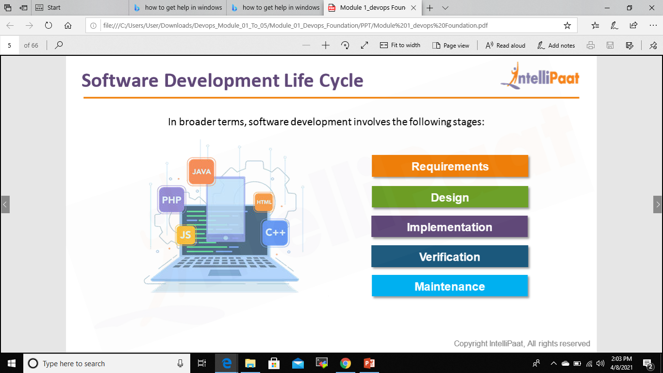
Software Development Cycle

Slide 5
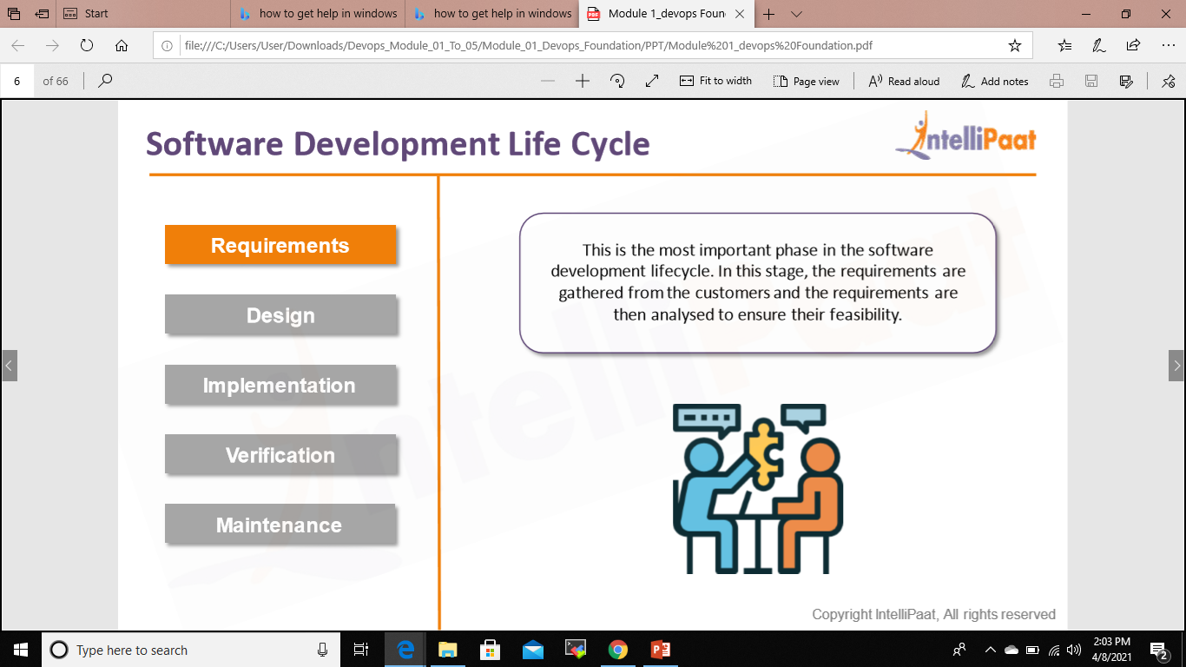
Software Development Cycle

Slide 6
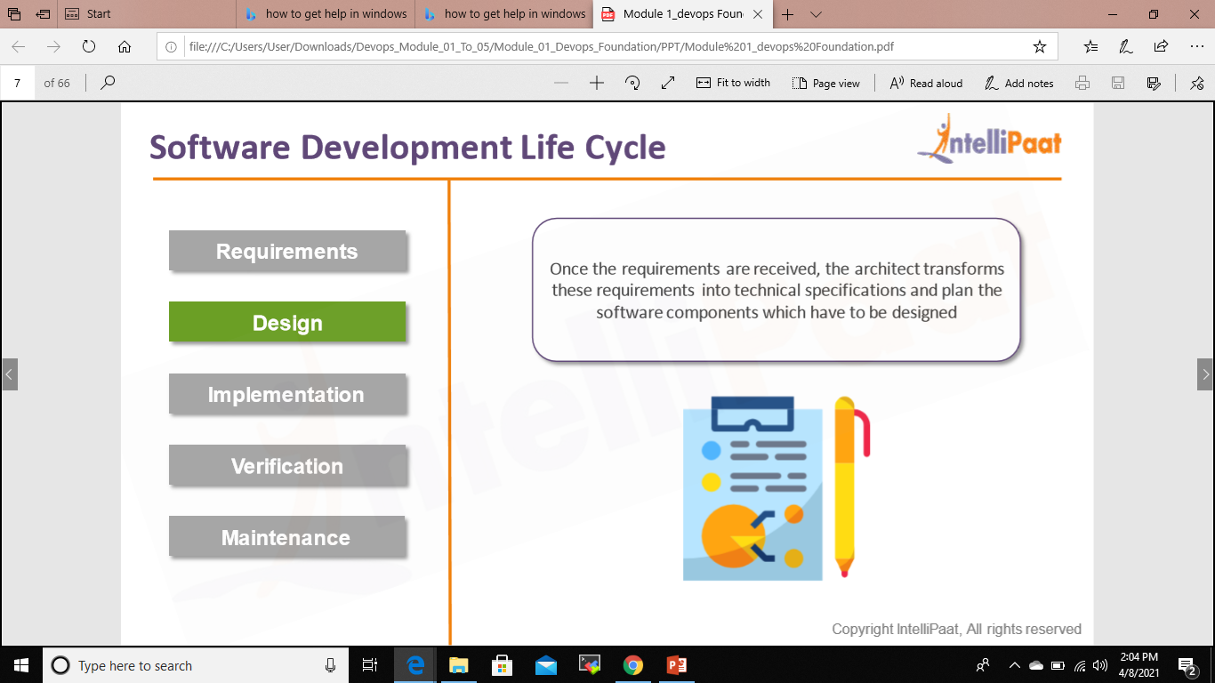
Software Development Cycle

Slide 7
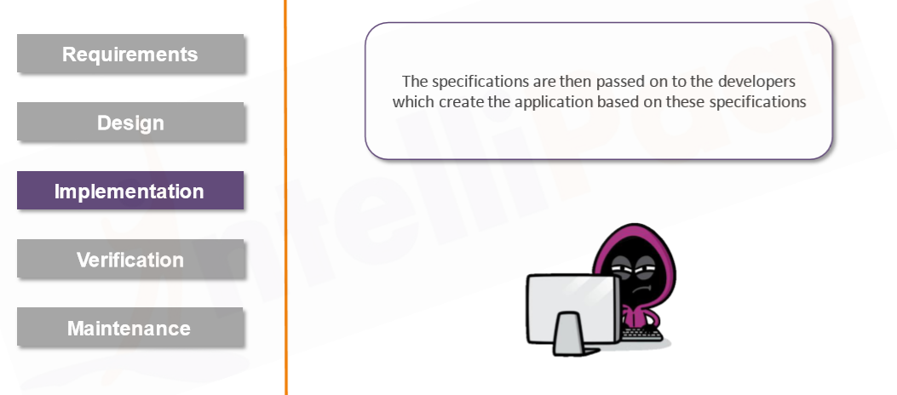
Software Development Cycle

Slide 8
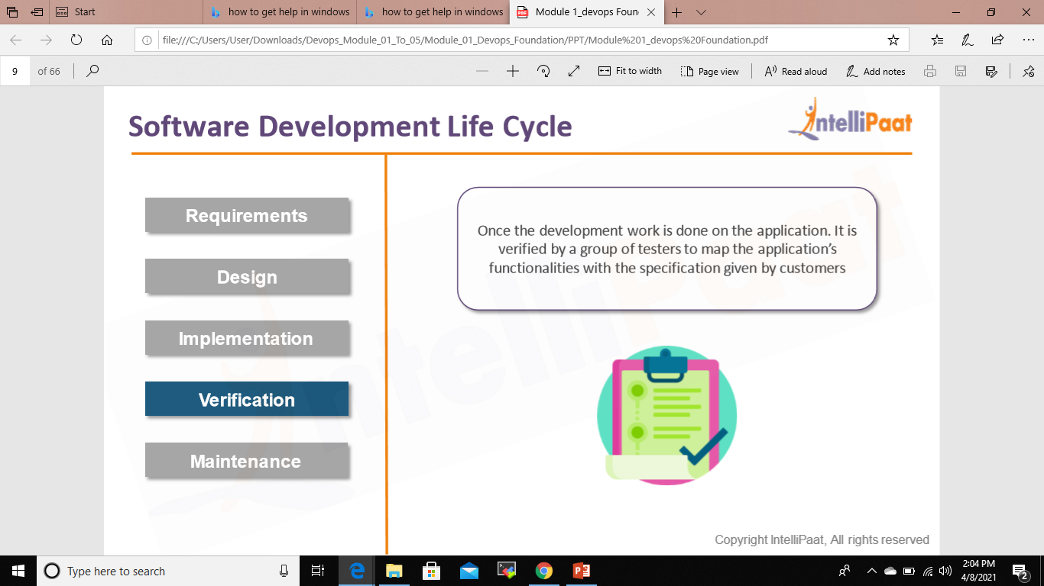
Software Development Cycle

Slide 9
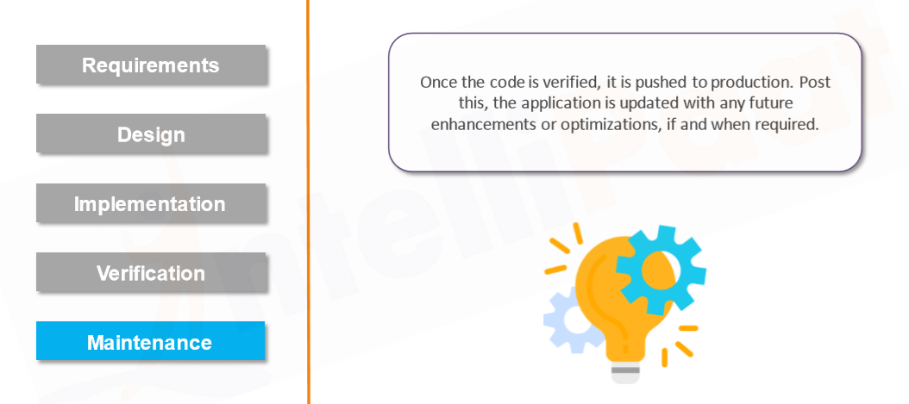
Software Development Cycle

Slide 10
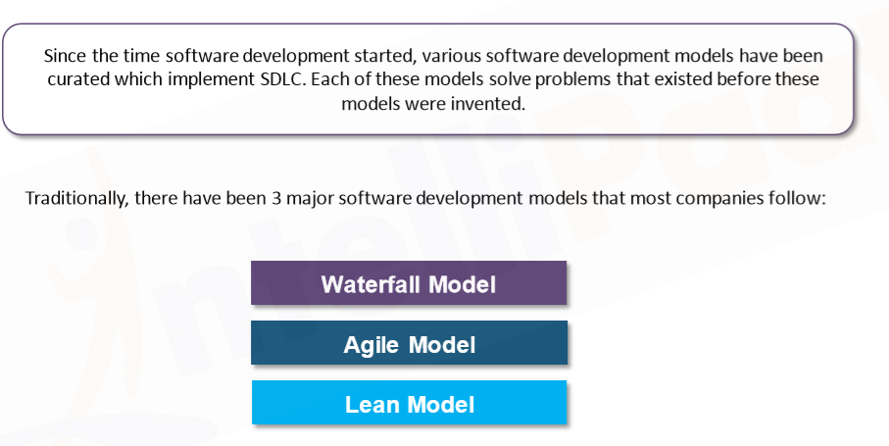
SDLC Models

Slide 11
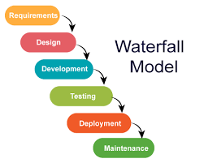

Slide 12
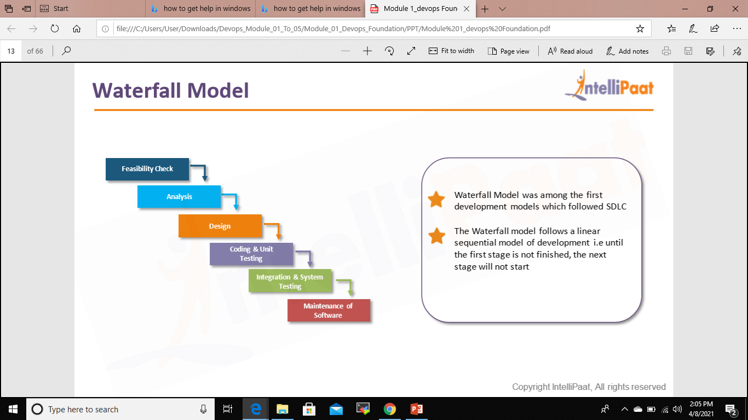
Waterfall Model

Slide 13
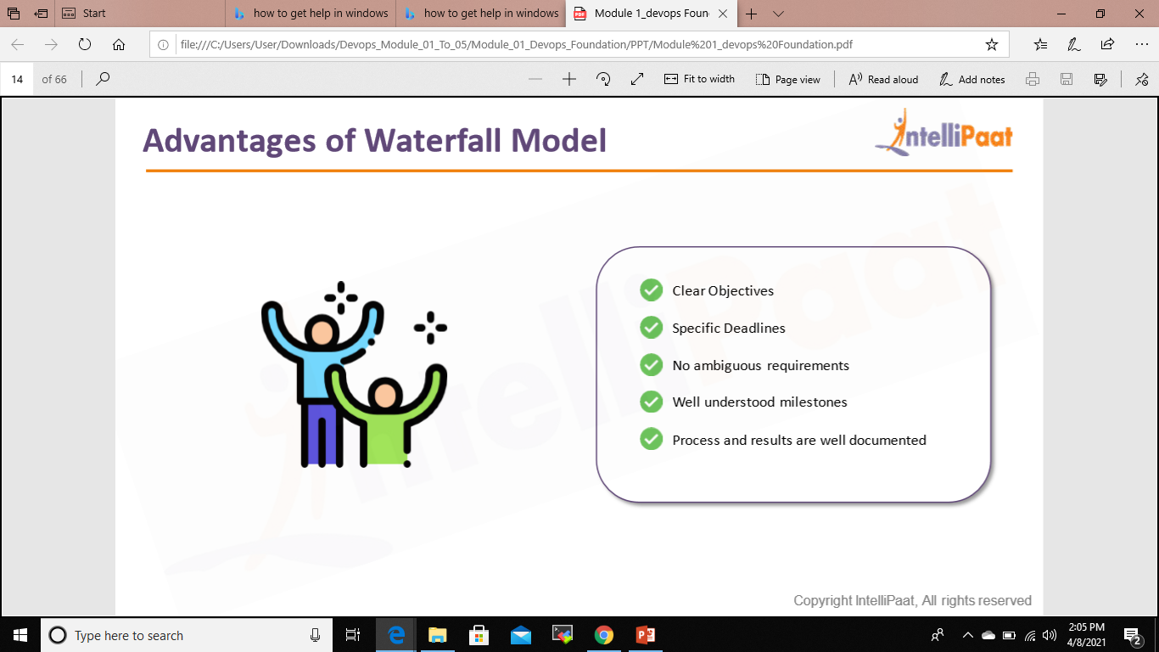
ADVANATAGES OF WATERFALL MODEL

Slide 14
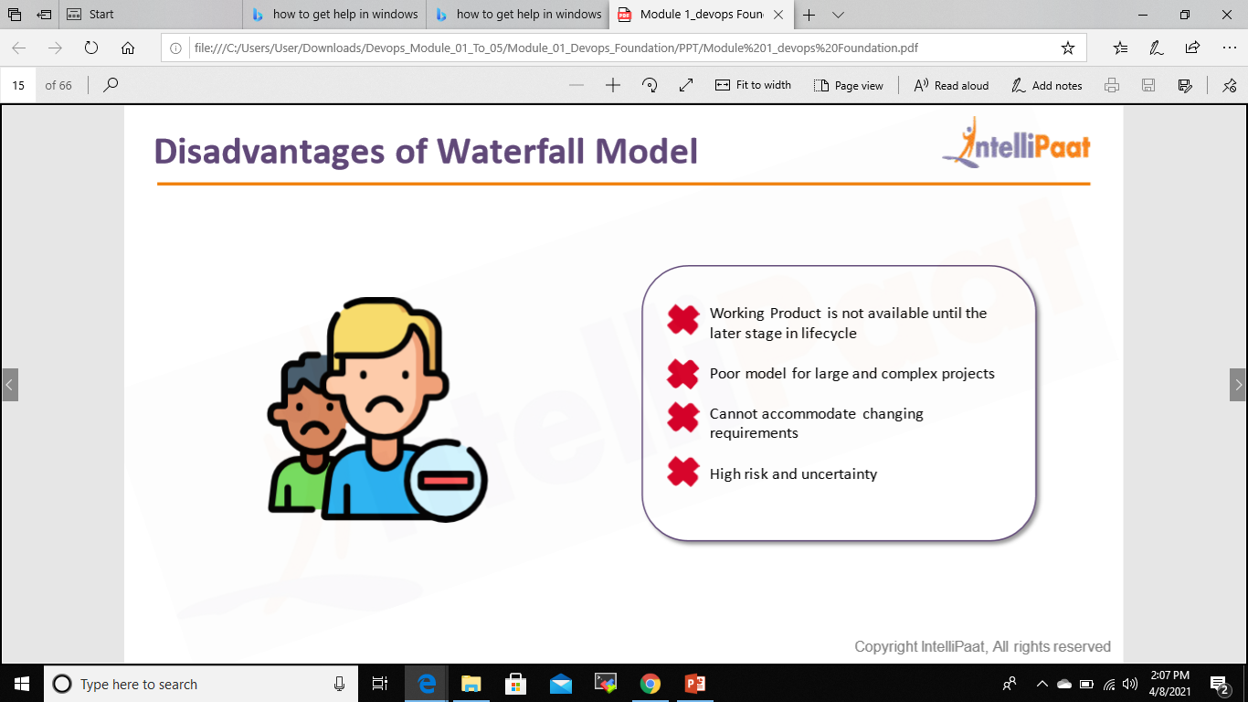
DISADVANATAGES OF WATERFALL MODEL

Slide 15
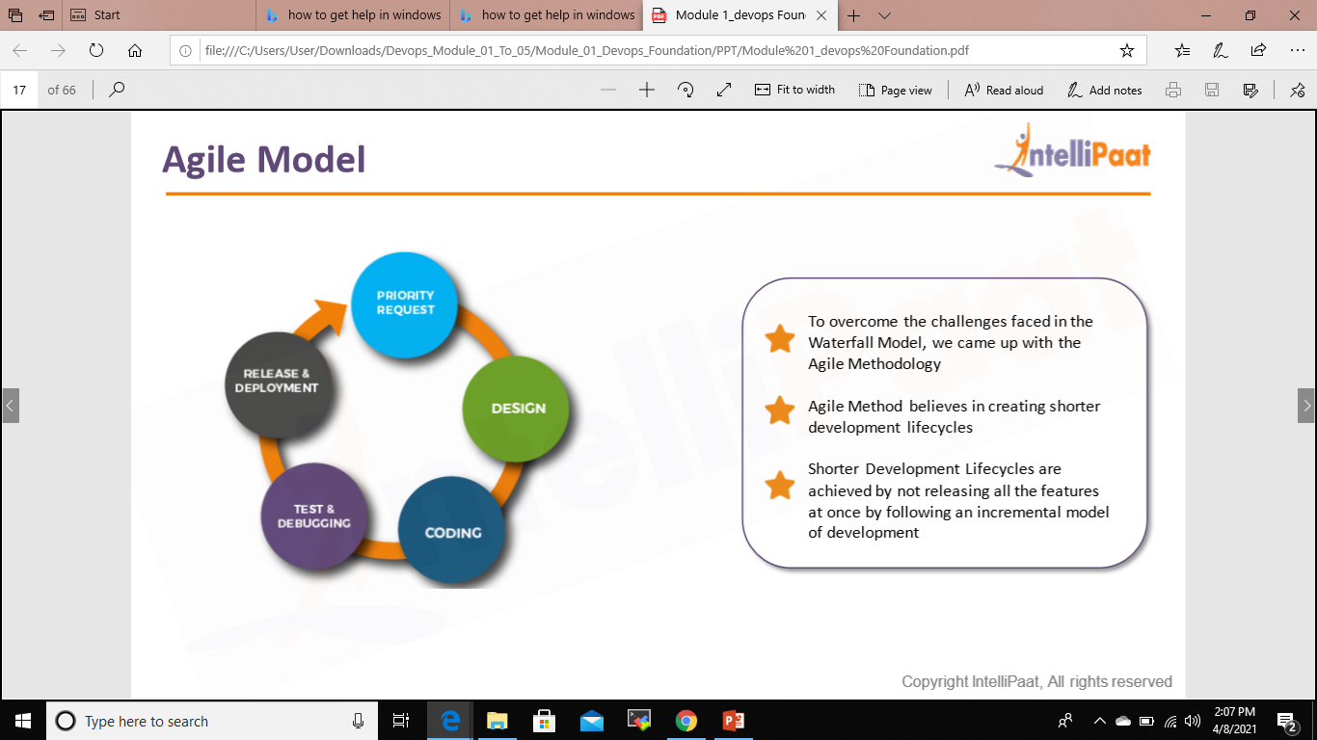
AGILE MODEL

Slide 16
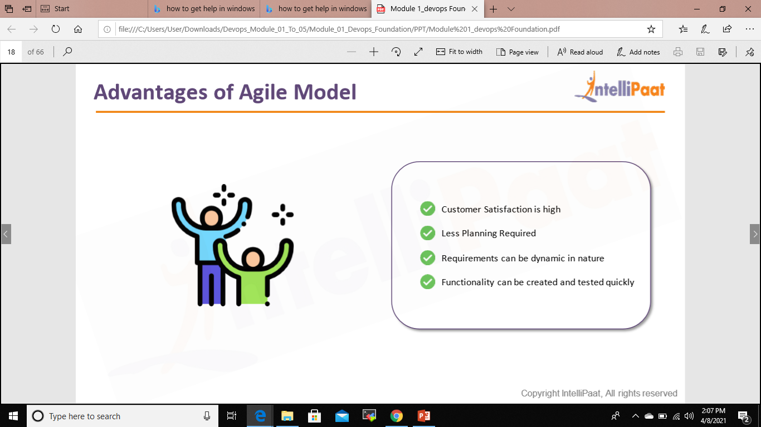
ADVANTAGES OF AGILE MODEL

Slide 17
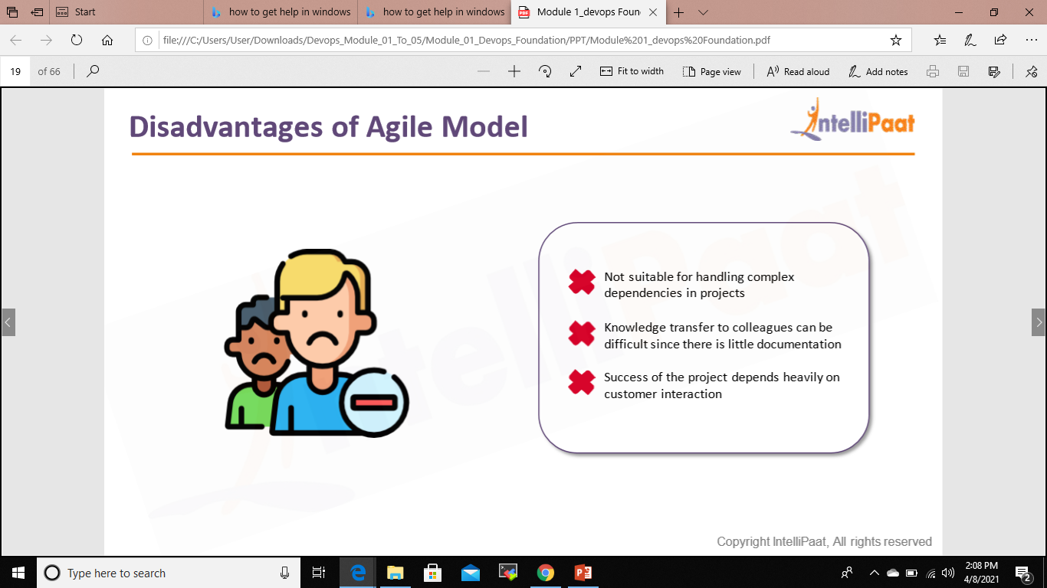
DISADVANTAGES OF AGILE MODEL

Slide 18
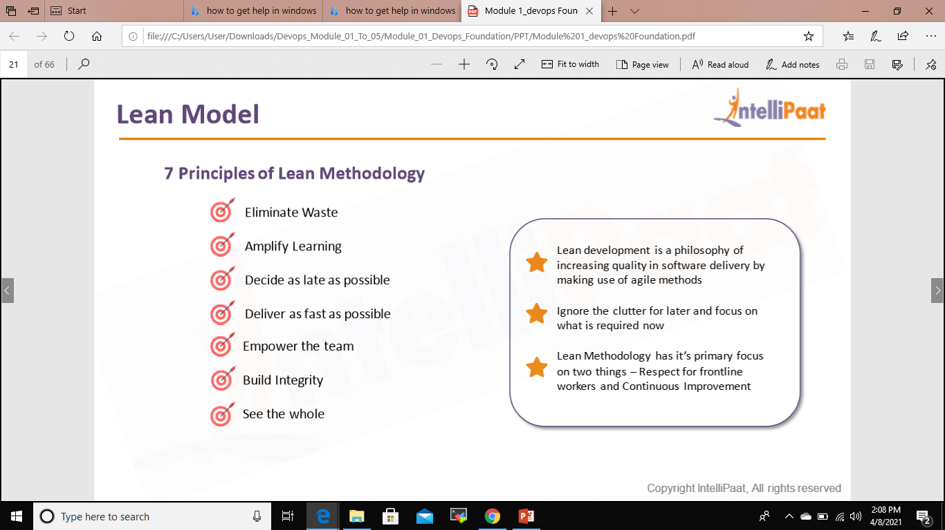
LEAN MODEL

Slide 19
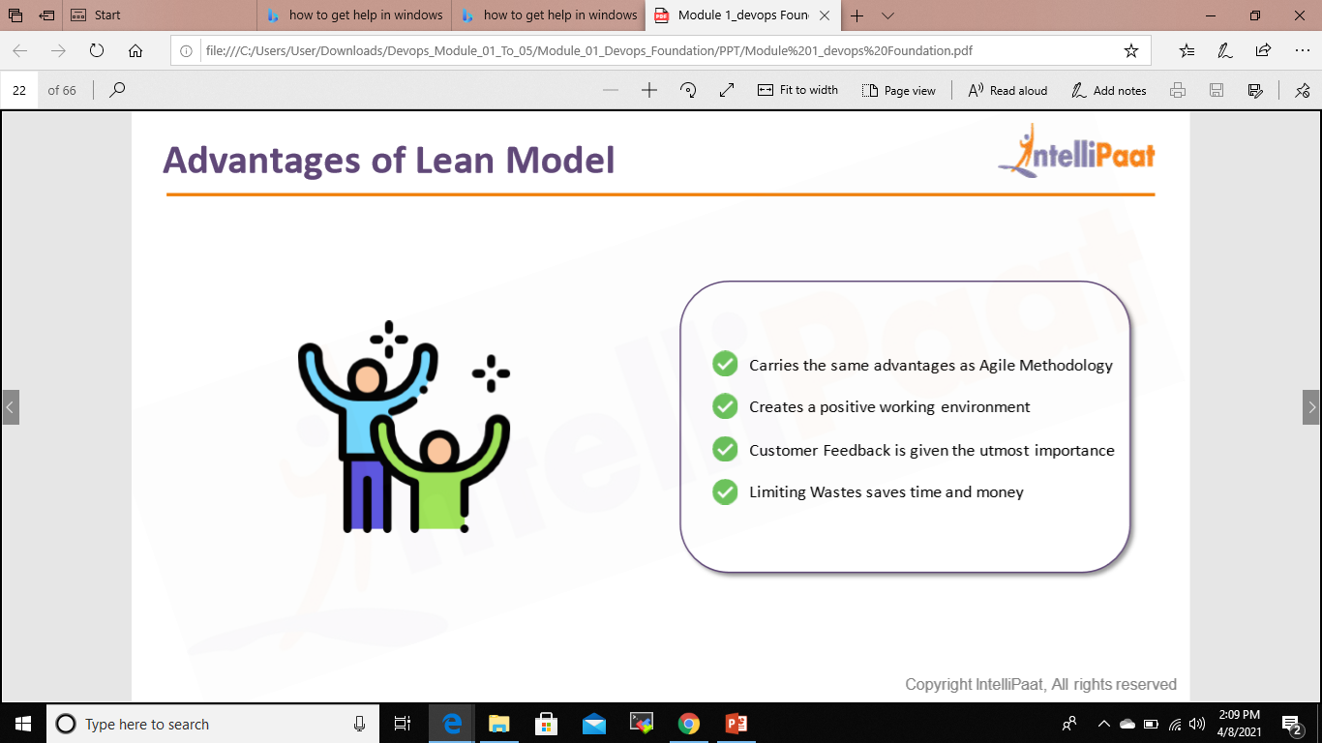
ADVANATGE OF LEAN MODEL

Slide 20

DISADVANATAGES OF LEAN MODEL

Slide 21
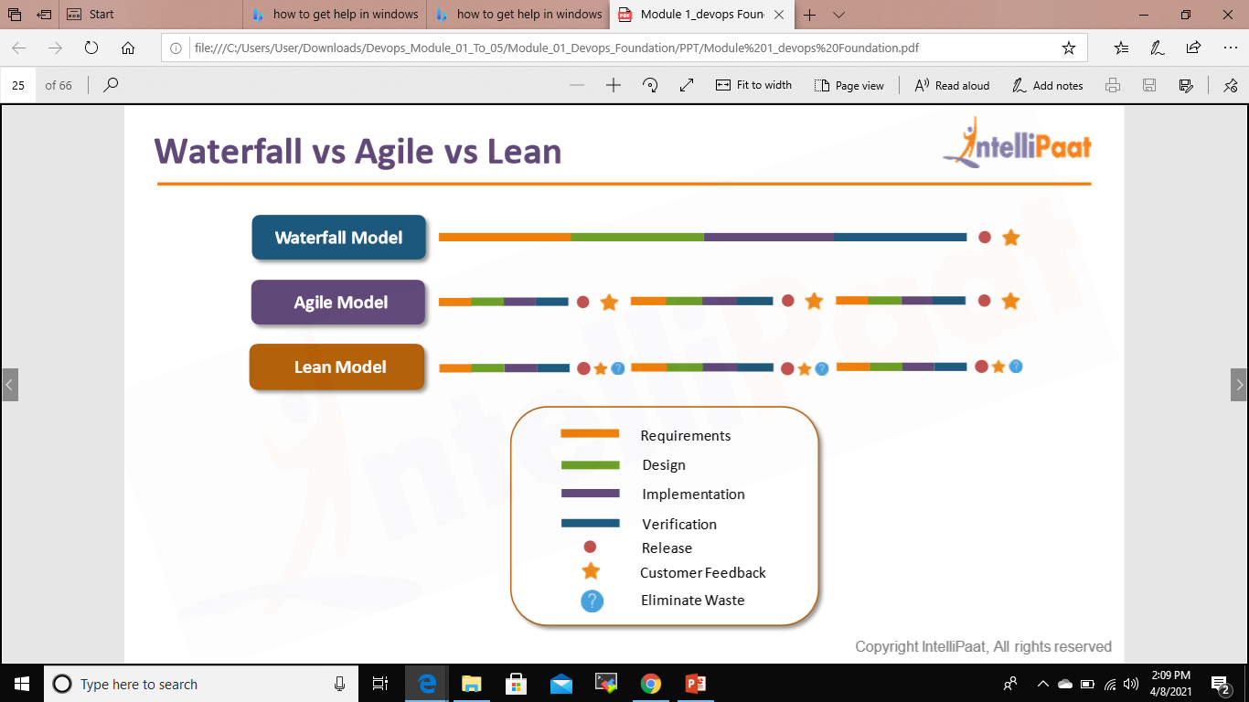
Waterfall vs Agile vs Lean

Slide 22
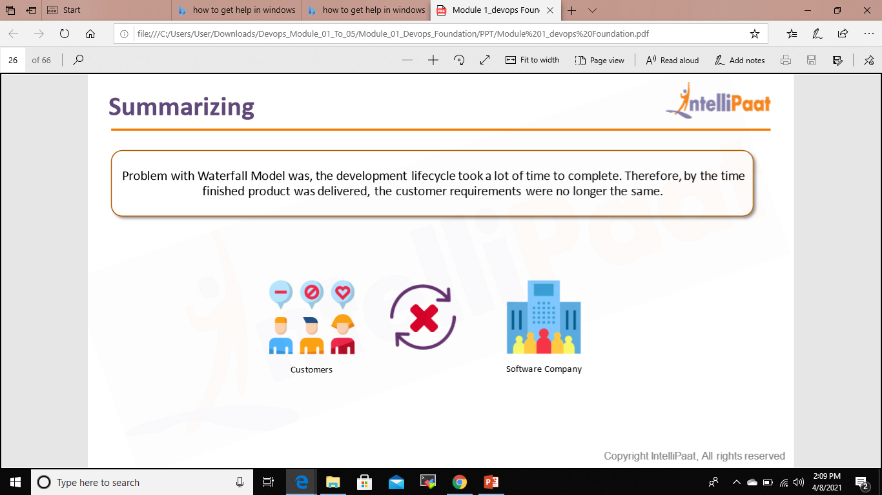
Summarizing

Slide 23
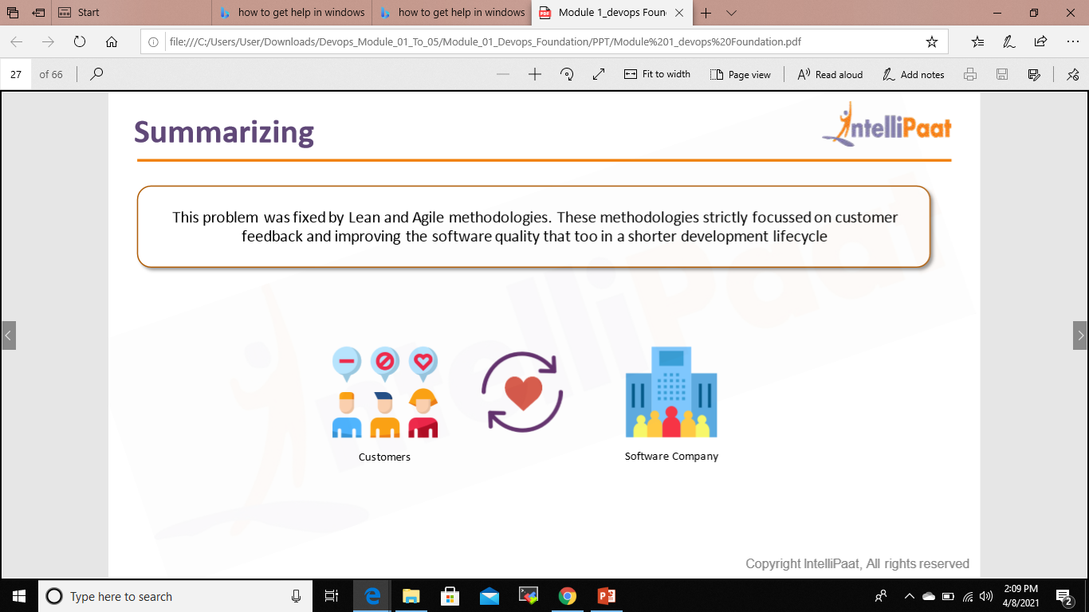
Summarizing

Slide 24
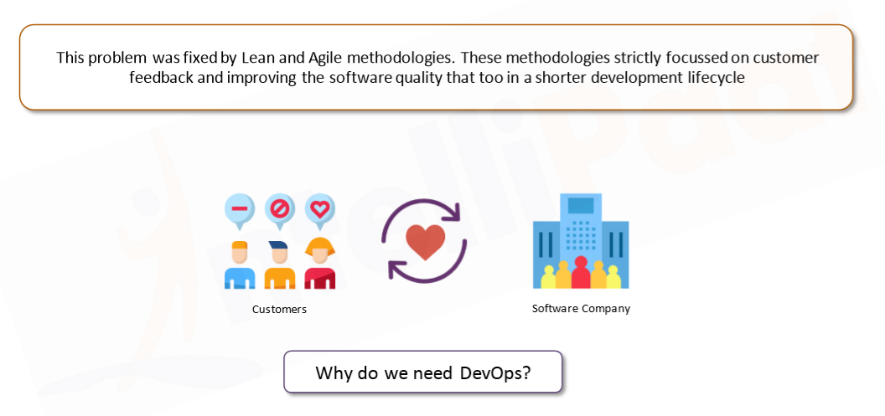
Summarizing

Slide 25
Breaking down silos between Development & Operations
I was speaking with a few colleagues recently about DevOps transformations happening in plenty of organizations these days. Most of them have started focusing on speed to market with agile movement, cost reduction by automating everything and shifting testing to left. But interestingly, very few are paying attention to cultural hindrance between Development and Operations teams in traditional SDLC.
Development and Operations are two sides of an equation, each holding its own roles and responsibilities. DevOps doesn’t mean eliminating some of the Ops role; rather about breaking silos between Dev and Ops, encouraging collaboration and effective communication throughout the product lifecycle. Let us look at a few key aspects around breaking silos between Dev and Ops.

Slide 26
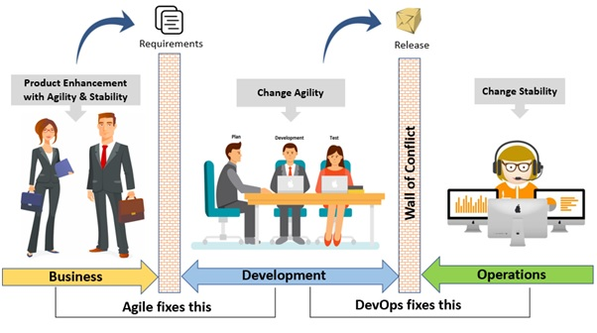
Without DevOps The Development team works on code which is then sent to the testing team for validation against requirements. Operation team comes in toward the end of the process, where handover of release is given. DevOps aims to break these silos enabling better collaboration and performance.

Slide 27
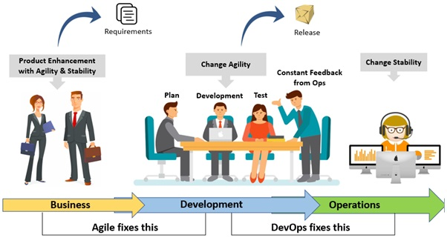
With DevOps The Development and Operations teams work in collaboration to minimize the effort and risk involved in releasing software. But how do you ensure collaboration? This is the question faced by many organizations. Well, you can introduce collaboration by ensuring that the Operations team is giving constant feedback to the Development team about the code, analyzing the impact considering end users and troubleshooting any problems together to gain stability of the product.
DevOps enables a cultural change to remove the barrier between development and operations, working together for common set of objectives.

Slide 28
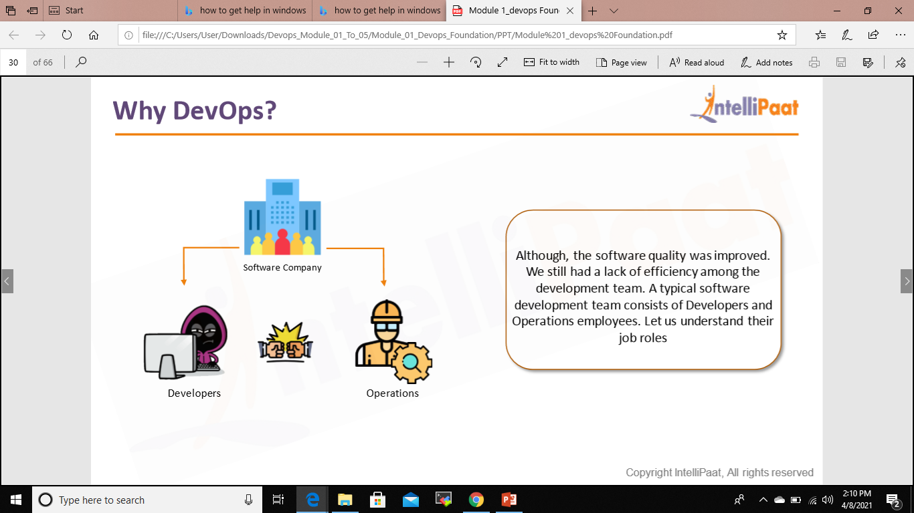
Why DevOps?

Slide 29
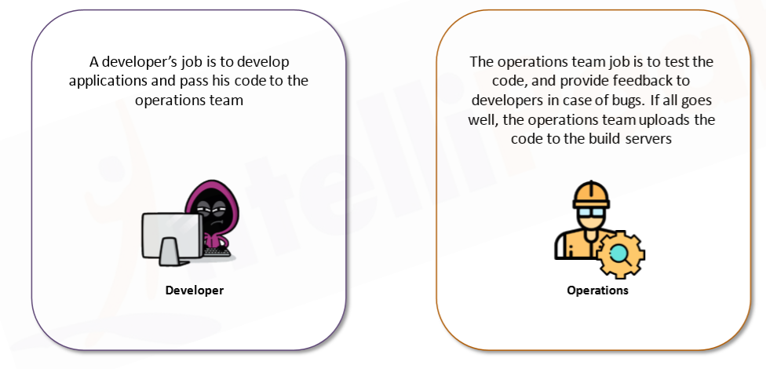
Why DevOps?

Slide 30
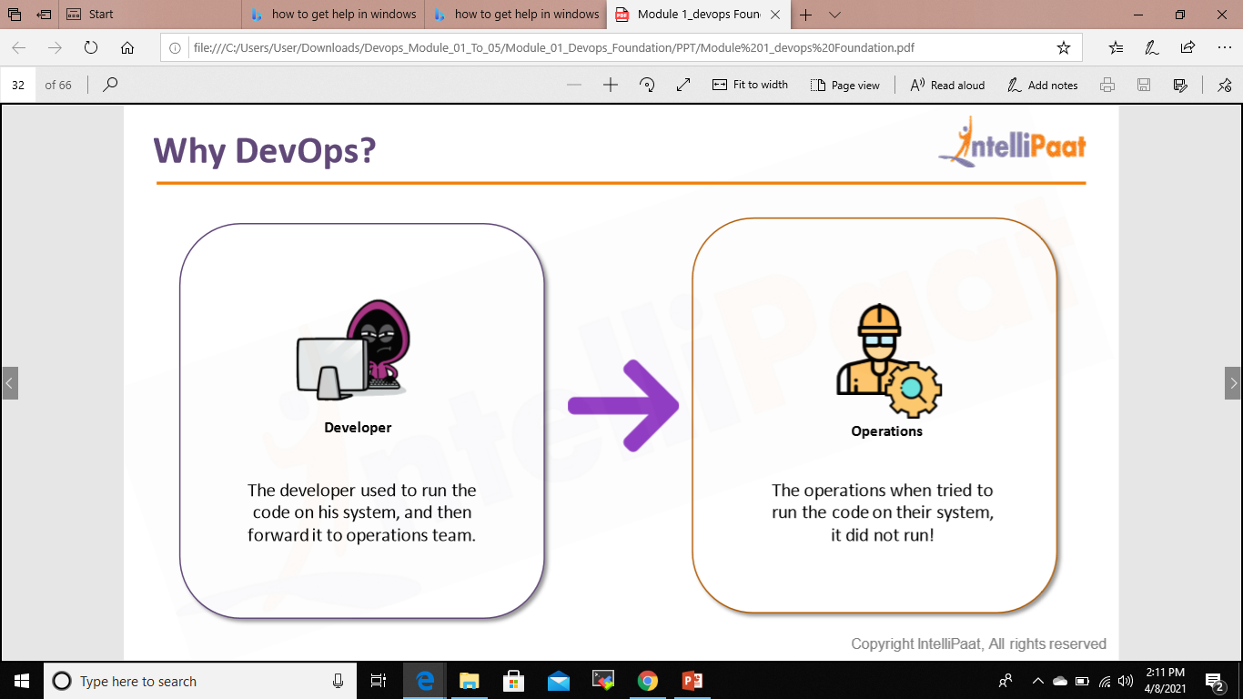
Why DevOps?

Slide 31
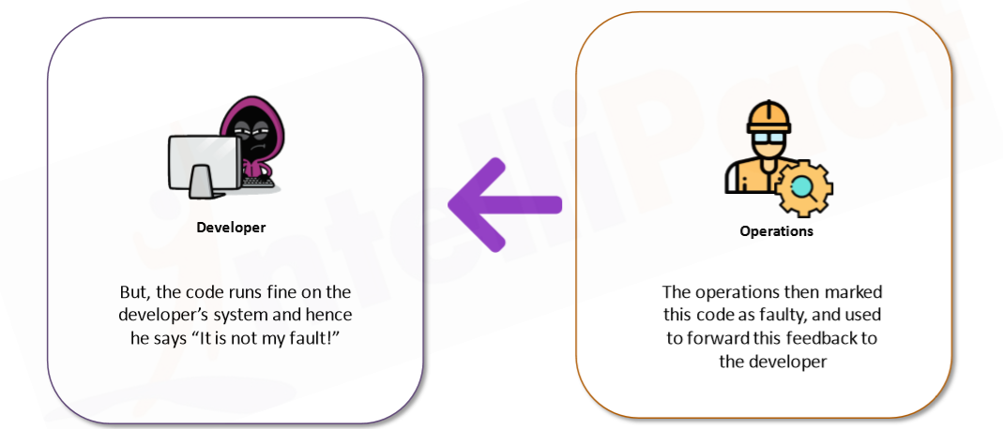
Why DevOps?

Slide 32
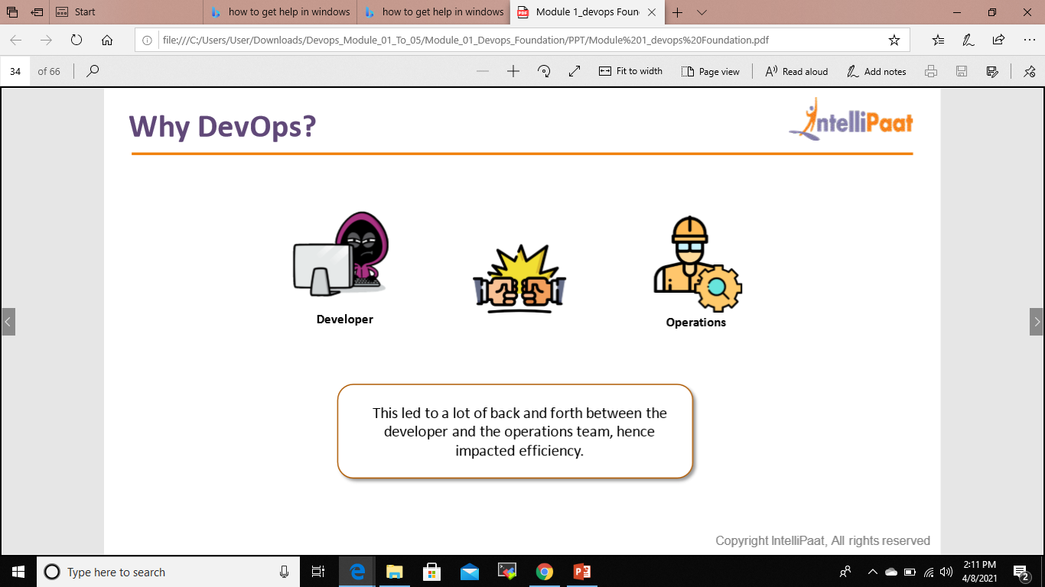
Why DevOps?

Slide 33
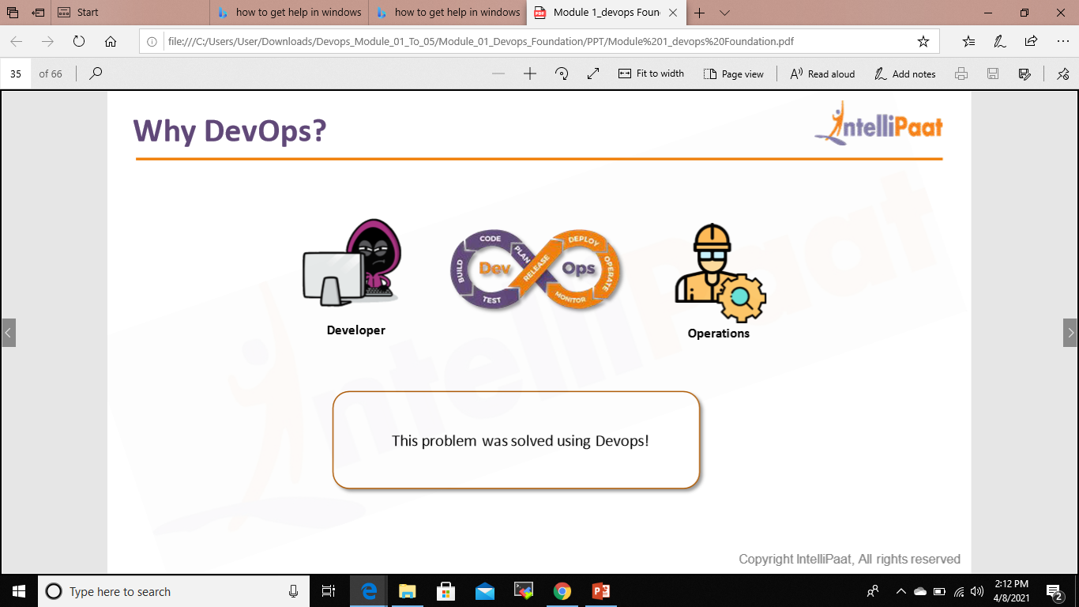
Why DevOps?

Slide 34
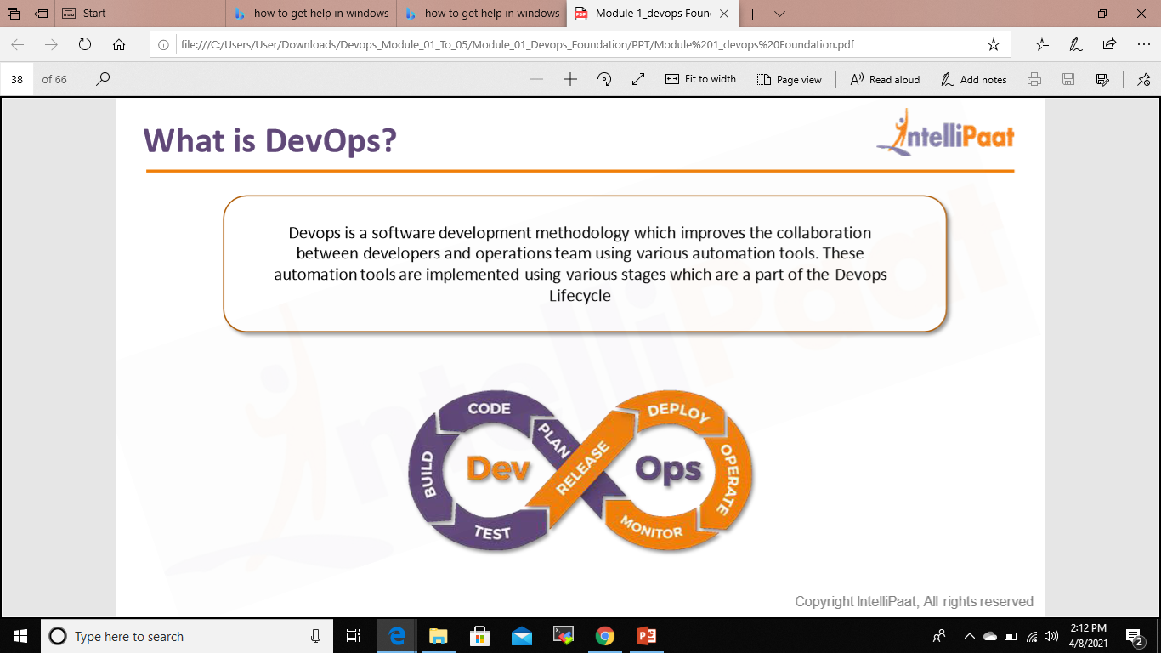
What is DevOps?

Slide 35

DevOps Model Defined
DevOps is the combination of cultural philosophies, practices, and tools that increases an organization’s ability to deliver applications and services at high velocity: evolving and improving products at a faster pace than organizations using traditional software development and infrastructure management processes.
This speed enables organizations to better serve their customers and compete more effectively in the market.

Slide 36
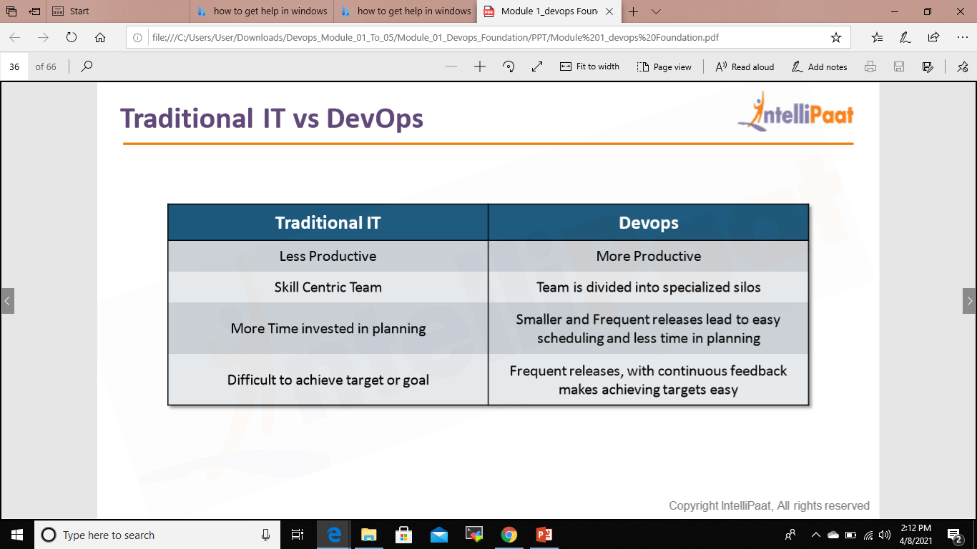
Traditional IT vs DevOps

Slide 37


Benefits of DevOps
Speed
Move at high velocity so you can innovate for customers faster, adapt to changing markets better, and grow more efficient at driving business results. The DevOps model enables your developers and operations teams to achieve these results. For example, microservices and continuous delivery let teams take ownership of services and then release updates to them quicker.
2 .Rapid Delivery
Increase the frequency and pace of releases so you can innovate and improve your product faster. The quicker you can release new features and fix bugs, the faster you can respond to your customers’ needs and build competitive advantage. Continuous integration and continuous delivery are practices that automate the software release process, from build to deploy

Slide 38
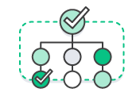
3. Reliability
Ensure the quality of application updates and infrastructure changes so you can reliably deliver at a more rapid pace while maintaining a positive experience for end users. Use practices like continuous integration and continuous delivery to test that each change is functional and safe. Monitoring and logging practices help you stay informed of performance in real-time.
4. Scale
Operate and manage your infrastructure and development processes at scale. Automation and consistency help you manage complex or changing systems efficiently and with reduced risk. For example, infrastructure as code helps you manage your development, testing, and production environments in a repeatable and more efficient manner.

Slide 39


5 .Improved Collaboration
Build more effective teams under a DevOps cultural model, which emphasizes values such as ownership and accountability. Developers and operations teams collaborate closely, share many responsibilities, and combine their workflows. This reduces inefficiencies and saves time (e.g. reduced handover periods between developers and operations, writing code that takes into account the environment in which it is run).
6. Security
Move quickly while retaining control and preserving compliance. You can adopt a DevOps model without sacrificing security by using automated compliance policies, fine-grained controls, and configuration management techniques. For example, using infrastructure as code and policy as code, you can define and then track compliance at scale.

Slide 40
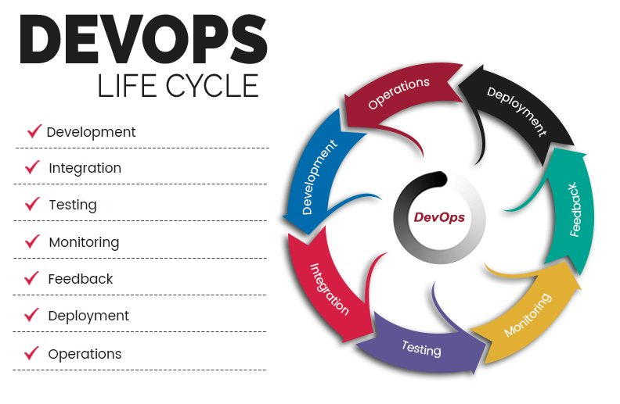

Slide 41
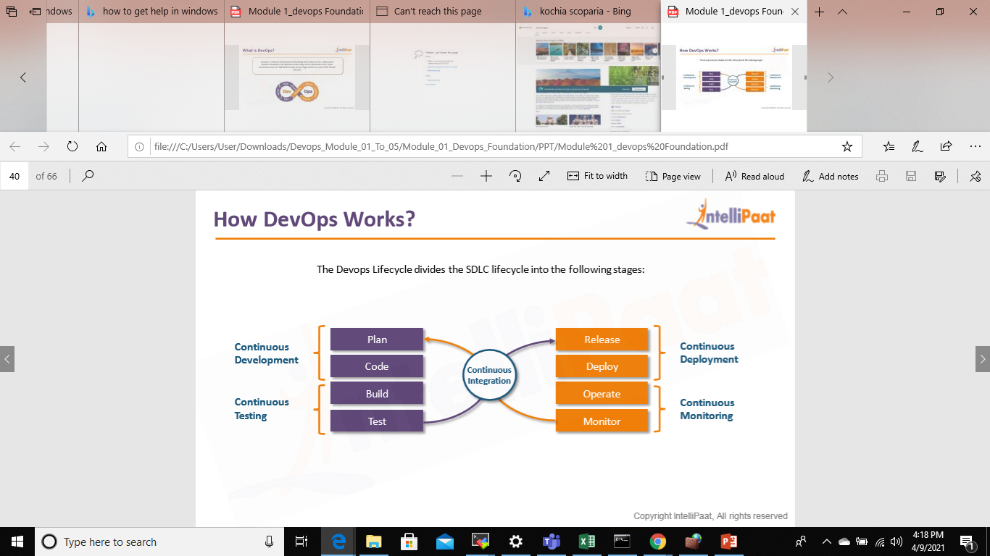
How DevOps Work?

Slide 42
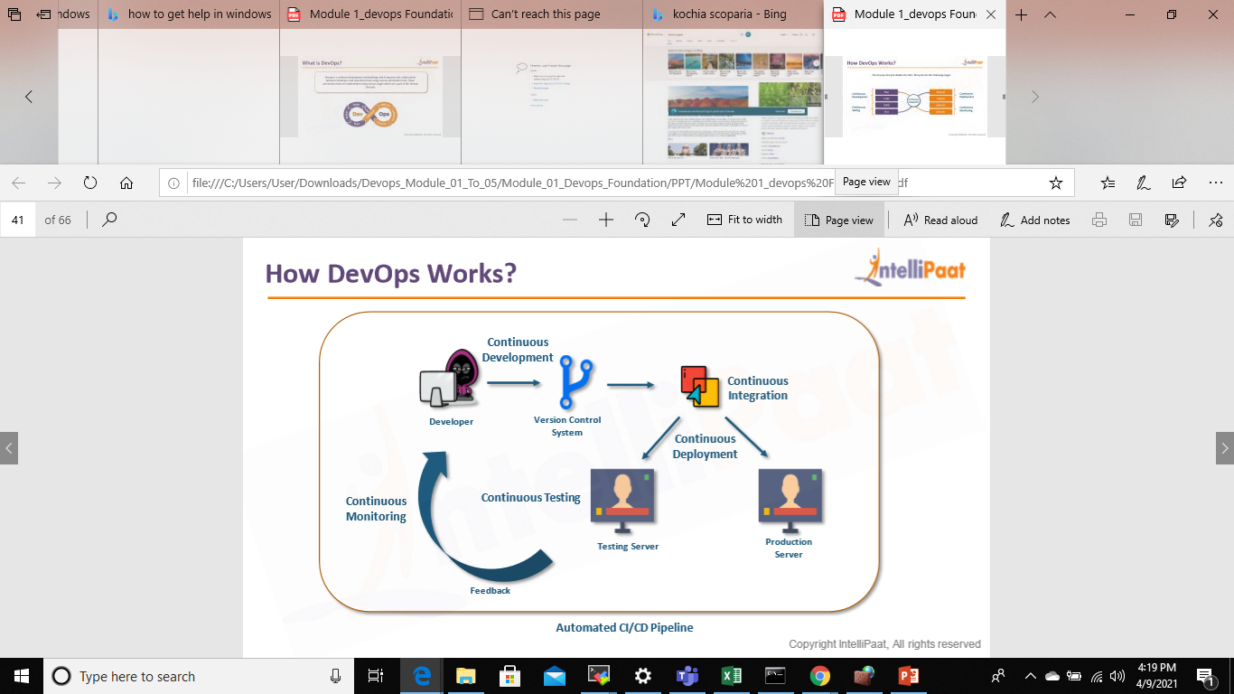
How DevOps Work?

Slide 43
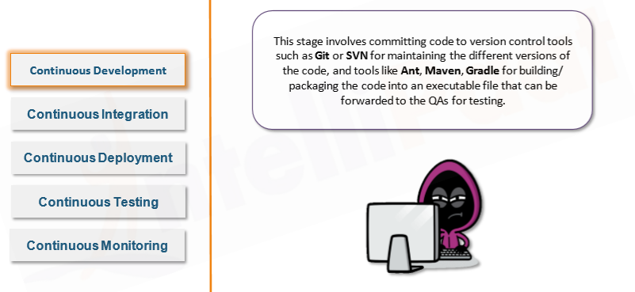
How DevOps Work?

Slide 44
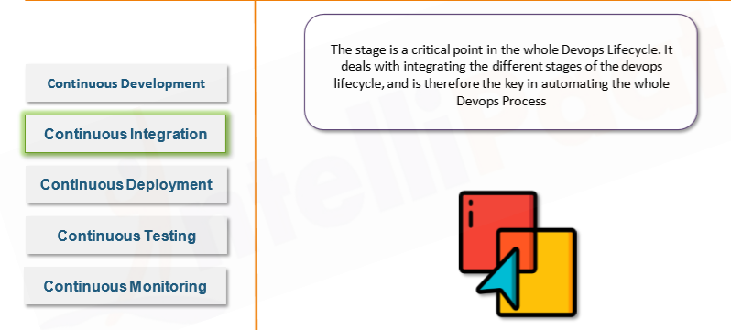
How DevOps Work?

Slide 45
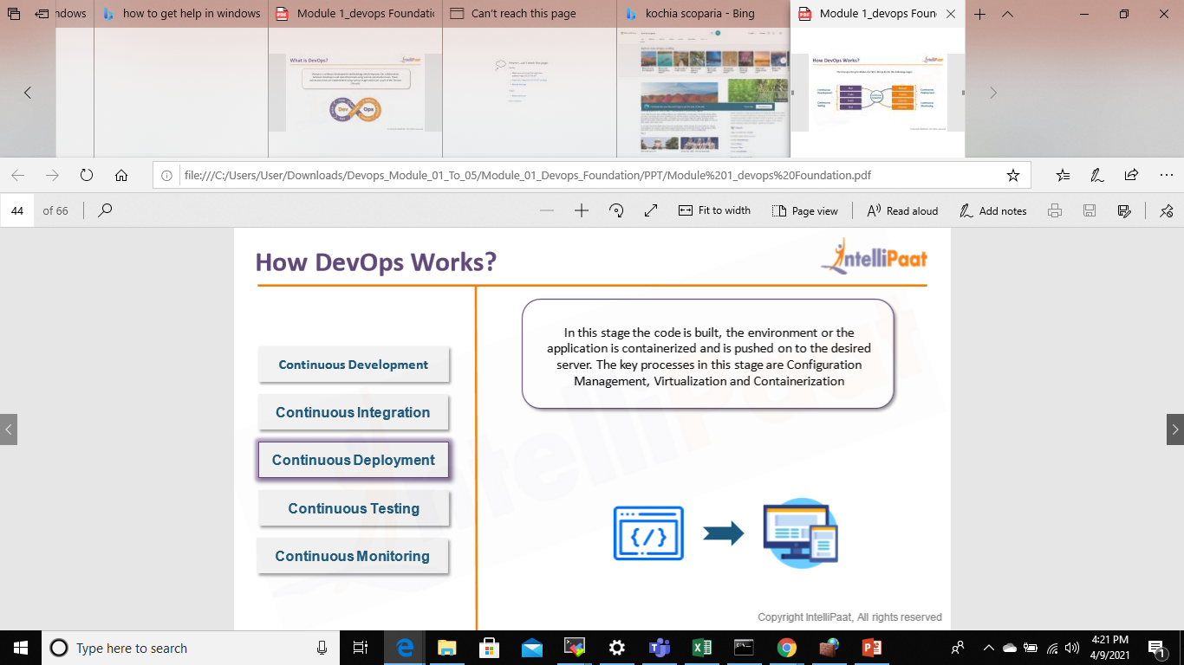
How DevOps Work?

Slide 46
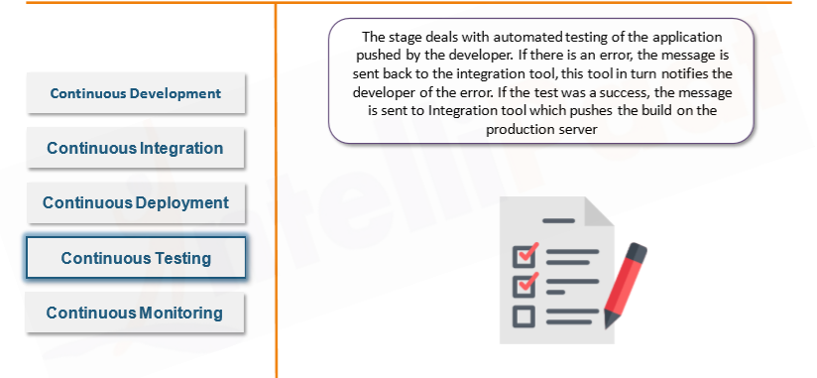
How DevOps Work?

Slide 47
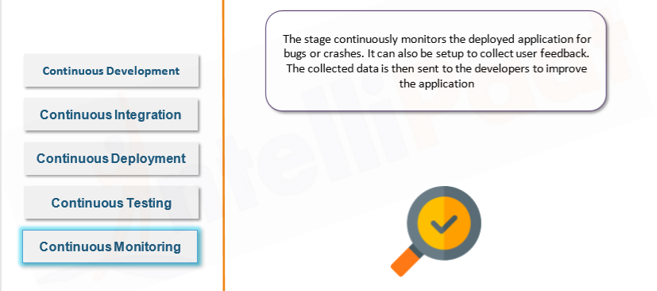
How DevOps Work?

Slide 48
Why DevOps Matters
Software and the Internet have transformed the world and its industries, from shopping to entertainment to banking. Software no longer merely supports a business; rather it becomes an integral component of every part of a business. Companies interact with their customers through software delivered as online services or applications and on all sorts of devices. They also use software to increase operational efficiencies by transforming every part of the value chain, such as logistics, communications, and operations. In a similar way that physical goods companies transformed how they design, build, and deliver products using industrial automation throughout the 20th century, companies in today’s world must transform how they build and deliver software.

Slide 49
How to Adopt a DevOps Model
Transitioning to DevOps requires a change in culture and mindset. At its simplest, DevOps is about removing the barriers between two traditionally siloed teams, development and operations.
In some organizations, there may not even be separate development and operations teams; engineers may do both. With DevOps, the two teams work together to optimize both the productivity of developers and the reliability of operations.
They strive to communicate frequently, increase efficiencies, and improve the quality of services they provide to customers. They take full ownership for their services, often beyond where their stated roles or titles have traditionally been scoped by thinking about the end customer’s needs and how they can contribute to solving those needs. Quality assurance and security teams may also become tightly integrated with these teams.
Organizations using a DevOps model, regardless of their organizational structure, have teams that view the entire development and infrastructure lifecycle as part of their responsibilities

